Slide 1


SAP BTP Training
Cloud Foundry Training

Slide 2

DISCLAIMER
The training content and delivery of this presentation is confidential, and cannot be recorded, or copied and distributed to any third party, without the written consent of Anubhav Trainings

Slide 3

LEARNING OBJECTIVES
Working with UI
Create a CURDQ Application using Spring boot and PostgreSQL
Explain How to Run PostgreSQL in SAP CF,
Manifest.yml file and Deploy application to CF
What is SAP UI5?
How to create simple UI5 page
Test UI5 page
Working with MVC
Create First View and Controller
--BREAK--
Integrate Service
Create Promise API with JS
Perform CURD using UI
Test Application locally
Understand Backing service
Start Postgre backing service

Slide 4
HANDS-ON: CREATE CURDQ APP FOR LOCAL POSTGRESQL
Design an Entity of Vendor and its address in the Spring boot app
Connect the application to the PostgreSQL in local system
Implement and test all CURDQ operations using REST API
Id
firstName
lastName
companyName
Website
emailId
gstNo
Vendor
Id
type
street
city
country
region
Address
1
*

Slide 5
Vendor
Address
vendorController
All the service mappings were provided in this class to call vendor service for DB operations.
vendorService
We are developing modular software, this extra layer will just used to pass data to vendor persistence to save in DB.
entities.Vendor
POJO – Which represent the skeleton of our table. @Entity, @Id
@Column
IVendorPersistence
This will provide a auto implementation to perform CURDQ operations using EntityFactory provided by spring
spring-boot-starter-data-jpa
Spring jpa dependency is Java Persistence API which is responsible to transform Java object to Database records. Class to tables.
POSTGRE SQL
To store our tables and data

Slide 6
Vendorid | Name
1 | SAP
2 | Apple
3 | IBM
Addressid | Address | vendor
1001 | Deterhopp alley | 1
1002 | ITPL Bangalore | 1

Slide 7
HANDS-ON: CREATE CURDQ APP FOR CF POSTGRESQL
Create a PostgreSQL Service in SAP CF
Connect to the service and test the app
# ===============================
# = DATA SOURCE
# ===============================
# Set here configurations for the database connection
spring.datasource.url=jdbc:postgresql://connectionurl:5432/mufpwelo
spring.datasource.username=userName
spring.datasource.password=password
spring.datasource.driver-class-name=org.postgresql.Driver
spring.jpa.show-sql=true
# Hibernate ddl auto (create, create-drop, update): with "create-drop" the database
# schema will be automatically created afresh for every start of application
spring.jpa.hibernate.ddl-auto=create
# Allows Hibernate to generate SQL optimized for a particular DBMS
spring.jpa.properties.hibernate.dialect=org.hibernate.dialect.PostgreSQLDialect

Slide 8
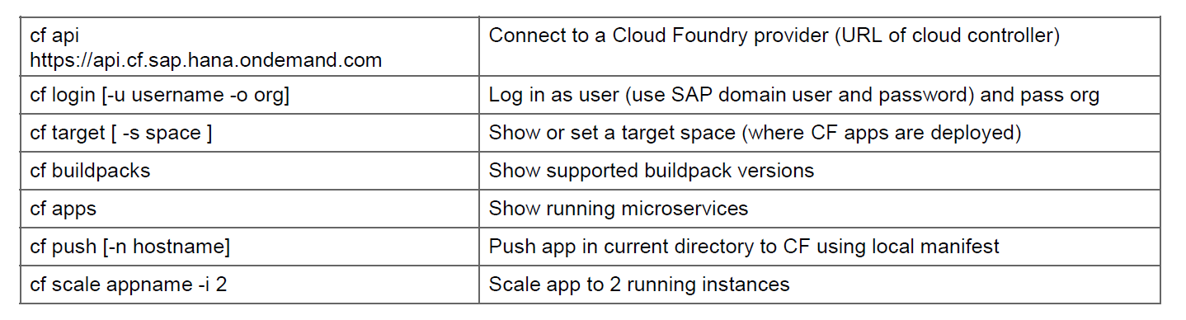
HANDS-ON: DEPLOY CURDQ APP IN CF
Add manifest.yml file to the app
Deploy the app to CF
---
applications:
- name: dbboot
random-route: true
memory: 1024M
path: /target/02dbboot-0.0.1-SNAPSHOT.war
buildpacks:
- java_buildpack
Solution:
https://github.com/soyuztechnologies/02dbboot.git

Slide 9



















HANDS-ON: CREATE A GITHUB REPOSITORY
Create an Account on https://www.github.com
Push your code to github

Slide 10
CONFIGURE CI PIPELINE
Create a CI pipeline using Jenkins
Configure Jenkins Server
Install Git Repository Plugin and Test(GitHub plugin)
Install Maven Plugin and Link to Jenkins( Maven Integration plugin )
Install Maven in System where Jenkins is Running
Set Classpath(M2_Home=Installation, M2=Bin File) and Test mvn –version
Install Maven Integration and Maven Invoker Plugin
Global Tool Configuration, Give Path M2_Home and Path
Test the Git and Maven, location of war file is in:
Install Cloud Foundry Plugin and Add to the Jenkins Task in Post build Actions
6. Provide Details of :
Cloud Foundry: API, Email and Password, Organization and Space is needed
7. Create a manifest.yml file and add content of path, application name etc.
8. Add Build Triggers and enable ‘Build whenever a SNAPSHOT dependency is built’
and Poll SCM with * * * * * for building every minute

Slide 11
What is SAP UI5?
SAP UI5 is a framework which is built on open standards (HTML5,CSS,JS,iQuery) to create Responsive Web Application.
Framework – collection of libraries
Library – Collection of classes
Class – Collection of Methods, Attributes, Events and Aggregations
Where we do we check documentation on SAP UI5?
SAP UI5 SDK – https://sapui5.hana.ondemand.com

Slide 12
What is SAP UI5?
SAP UI5 is a framework which is built on open standards (HTML5,CSS,JS,iQuery) to create Responsive Web Application.
Framework – collection of libraries
Library – Collection of classes
Class – Collection of Methods, Attributes, Events and Aggregations
Where we do we check documentation on SAP UI5?
SAP UI5 SDK – https://sapui5.hana.ondemand.com

Slide 13
Working with MVC
What is the development methodology used in developing?
MVC architecture is used in software industry to build UI applications.
Model – We keep all our application data into the model
View – The user interface with which user will interact with our application
Controller – Which is where our application logic is being kept
Event handlers
Controller
(Processing)
events
View (I/O)
Data binding
Model
(Data)

Slide 14
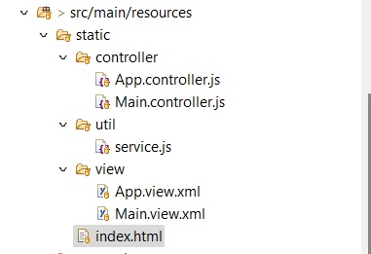
HANDS-ON: Create First MVC Application
Create your first MVC application with display data

Slide 15
HANDS-ON: Integrate with service API - Promises
Controller
Service.js
Vendor API
View
Asynchronous programming
https://www.youtube.com/watch?v=zY6gnfxgb9I
https://www.youtube.com/watch?v=oxxOPqoezjA

Slide 16





















Slide 17
HANDS-ON: DEPLOY CURDQ APP IN CF
Add manifest.yml file to the app
Deploy the app to CF
---
applications:
- name: dbboot
random-route: true
memory: 1024M
path: /target/02dbboot-0.0.1-SNAPSHOT.war
buildpacks:
- java_buildpack
Solution:
https://github.com/soyuztechnologies/02dbboot.git

Slide 18
Backing Service in CF
A backing service in CF is just a reusable service. We will use these backing service for different purpose
DB as a service – PosgreSQL, SAP HANA, SAP HANA HDI, Mongo, Redis
Queue – Rabbit MQ, Kafka
Authentication manager – UAA service
Connectivity Service
Our application will bind to these services and use them out-of-box. As a app developer we don’t have to worry about running most of these functionalities own our own.
Steps:
Start a new backing service instance
In order to access these backing service we need add a services entry in our app’s manifest.yml file
The cloud foundry also provides Environment variables, which we can use to connect to these backing service. This way its fully flexible. To check these environment variables we can use command cf env <appname>
Advantage:
Never need to hardcode our db credentials anywhere, the app will look for it and connects to it
Scale backing service individual
Complete management of backing service using CF cockpit or command line
Take care of auto binding in D, Q and Production
www.anubhavtrainings.com

Slide 19
Steps
Create a new instance of backing service – Postgre
Add an entry for that backing service in our manifest.yml
Delete the properties file which has hardcoding of DB connection
Add new dependencies in our project
Spring-cloud-cloudfoundry-connector
Spring-cloud-spring-service-connector
Ngdbc – DB Driver
Dbcp2
Org.eclipse.persistence.jpa
Implement 2 classes
Database Config class as described above, This class will use the variables to create a new data source connection. This data source connection will be passed to Spring JPA. Spring JPA needs EntityManager (Create, Alter DB Tables) and Transaction Manager(To CRUD). This class has 3 methods
Create a DB Connection
Create EntityManager by using our own DB Connection
Create Transaction Manager by using our own connection
Entity Manager class which will have all the settings and address of our entity classes.
We can change settings if we want into the EntityManager Factory.
Build project – skip test
Looking in CF environment a variable with name VCAP_SERVICES and parse it. Pass this information to a configuration class which we will register with spring. The class must inherit AbstractCloudConfig
Pool the connections and control the flow of calls to avoid flood to DB. Good for performance.
EclipseLink is a JPA implementation, which is responsible for creating EM, TR
www.anubhavtrainings.com

Slide 20
Step 1 – Add dependencies
<dependency>
<groupId>org.eclipse.persistence</groupId>
<artifactId>org.eclipse.persistence.jpa</artifactId>
<version>${org.eclipse.persistence.version}</version>
</dependency>
<!-- https://mvnrepository.com/artifact/org.springframework.cloud/spring-cloud-cloudfoundry-connector -->
<!-- https://mvnrepository.com/artifact/org.springframework.cloud/spring-cloud-cloudfoundry-connector -->
<dependency>
<groupId>org.springframework.cloud</groupId>
<artifactId>spring-cloud-cloudfoundry-connector</artifactId>
<version>2.0.7.RELEASE</version>
<scope>runtime</scope>
</dependency>
<!-- https://mvnrepository.com/artifact/org.springframework.cloud/spring-cloud-spring-service-connector -->
<dependency>
<groupId>org.springframework.cloud</groupId>
<artifactId>spring-cloud-spring-service-connector</artifactId>
<version>2.0.7.RELEASE</version>
</dependency>
<!-- https://mvnrepository.com/artifact/com.sap.cloud.db.jdbc/ngdbc -->
<dependency>
<groupId>com.sap.cloud.db.jdbc</groupId>
<artifactId>ngdbc</artifactId>
<version>2.7.13</version>
</dependency>
<!-- https://mvnrepository.com/artifact/org.apache.commons/commons-dbcp2 -->
<dependency>
<groupId>org.apache.commons</groupId>
<artifactId>commons-dbcp2</artifactId>
<version>2.8.0</version>
</dependency>
<properties>
<java.version>1.8</java.version>
<org.eclipse.persistence.version>2.7.3</org.eclipse.persistence.version>
</properties>

Slide 21
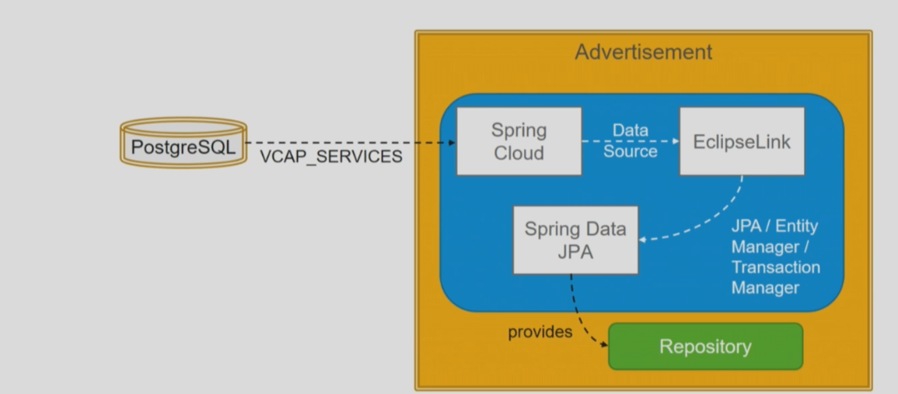
Access Environment Va riable - Postgre
www.anubhavtrainings.com

Slide 22
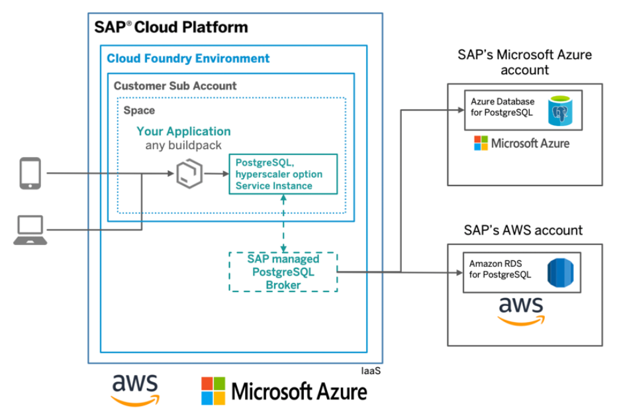
HANDS-ON: Setup Postgre Backing service in CF
SAP BTP

Slide 23

Summarize
LET’S SUMMARISE!

Slide 24

Summarize
End of Day 5

Slide 26


We’re committed to empower you to be
#FutureReady
through powerful training solutions.
We build the workforce of the future.
250+
Corporate Clients
30,000+
Learners Trained
25000+
Learners Placed
FREE WEBINARS
Sign up for free webinars with industry experts every fortnight!
Enroll Now!
Contact us today!
https://anubhavtrainings.com

